Slide 1
Pizza Delivered Quickly Factory Location Subsystem
Ron Alexi, Sekaji Maynard, Jason Charles

Slide 2
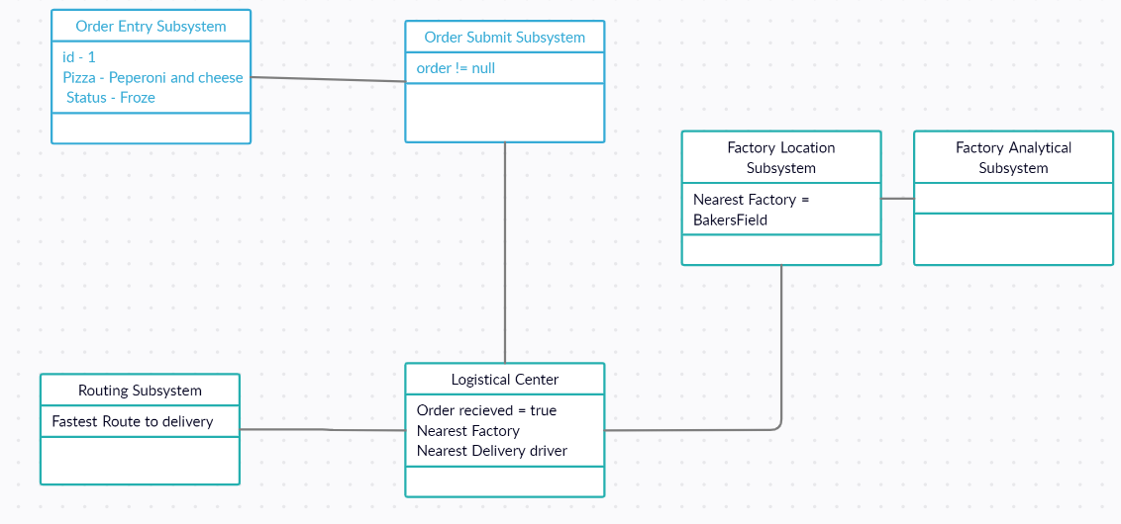
Overview
The product is to be a light weight application which allows for the branch to send orders to a factory and prepare them for delivery.

Slide 3

Database and Application
The application uses a swift front end to connect to realm server then allowing for use to connect to a mongo dB database to allow for the team to save persistent data on the backend that can then be called from the device or system multiple times

Slide 4
Pizza Delivered Quickly Factory Location Subsystem

Slide 5
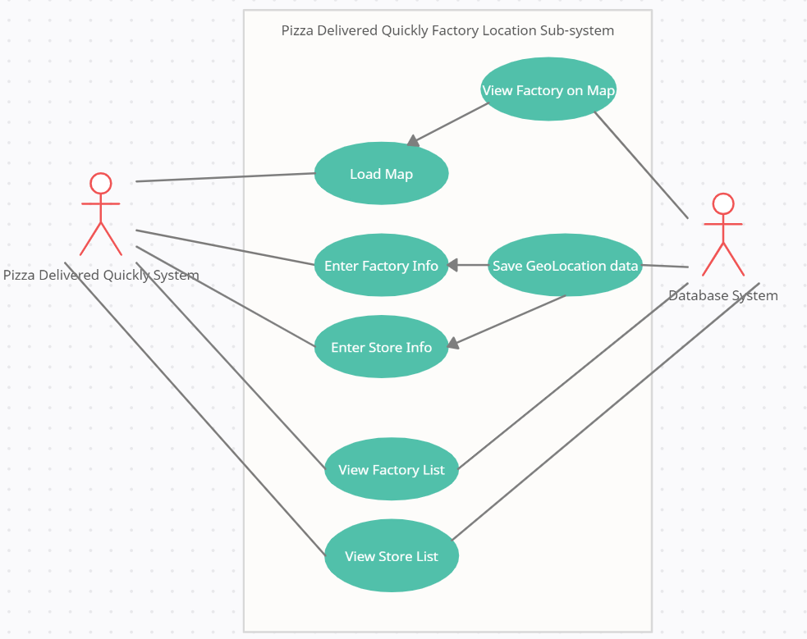
Use Case Diagram
This diagram shows the different requirements that are needed for the application to

Slide 6
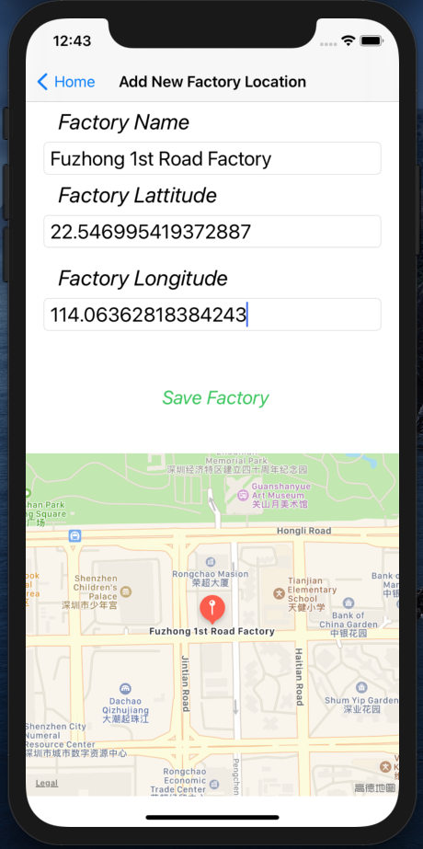
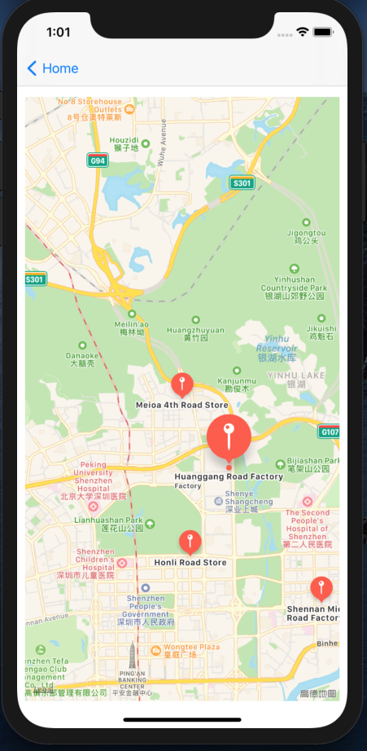
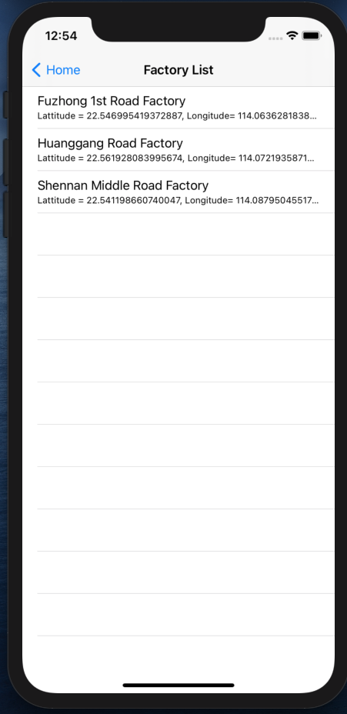
Demonstration

Slide 7
Pizza Delivered Quickly Factory Analytical Subsystem

Slide 8

Database
This application uses elastic search and kibana two powerful tools too allow for the querying of data and determining the placement of factories

Slide 9
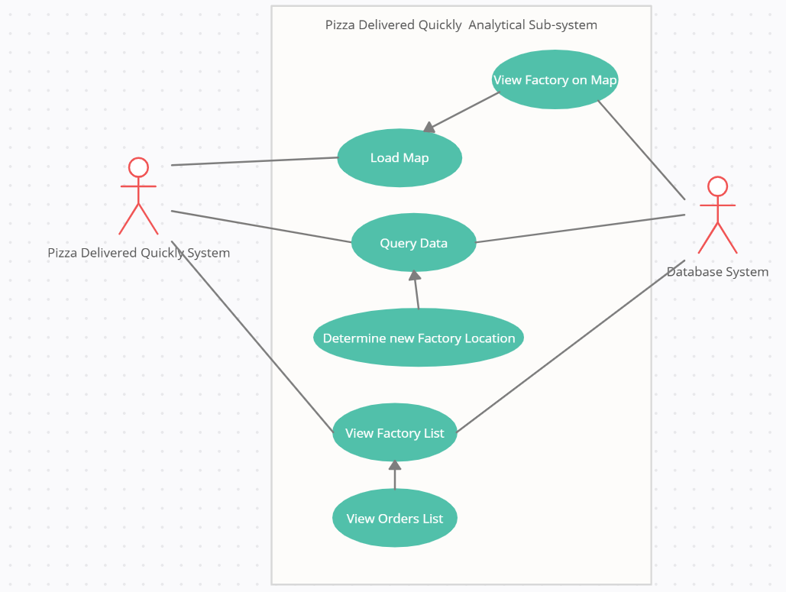
Use Case Diagram
This diagram shows the different requirements that are needed for the application to

Slide 10
Demonstration
Pizza Delivered Quickly Analytical Subsystem

Slide 11
Questions?

